Slide 1

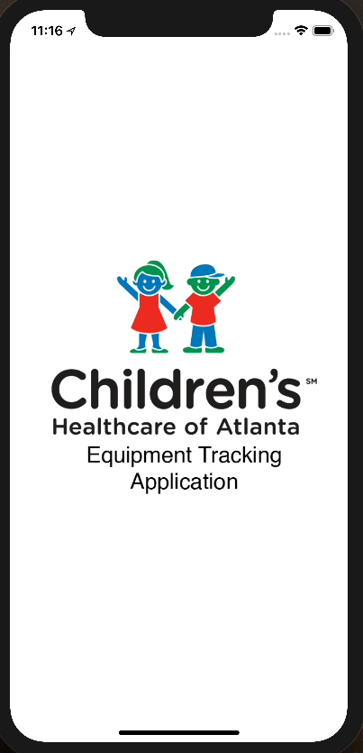
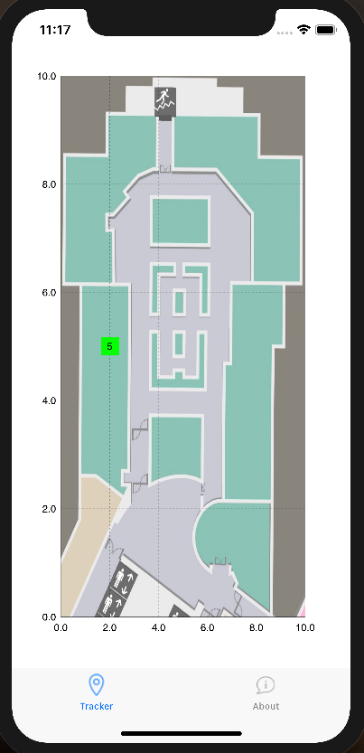
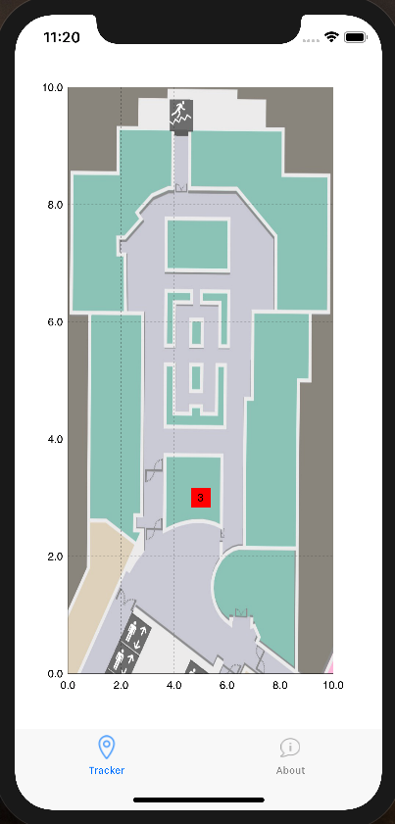
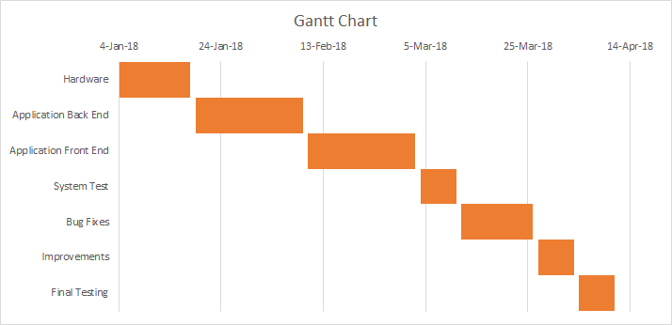
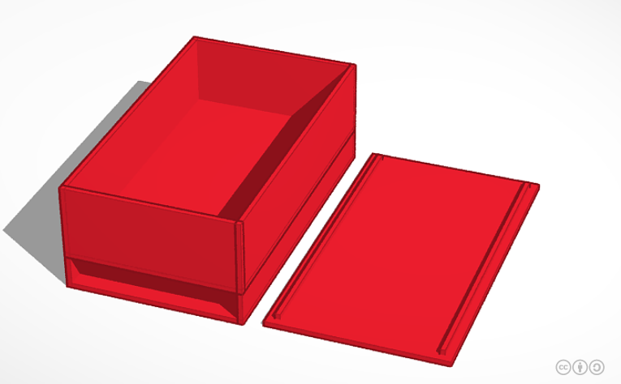
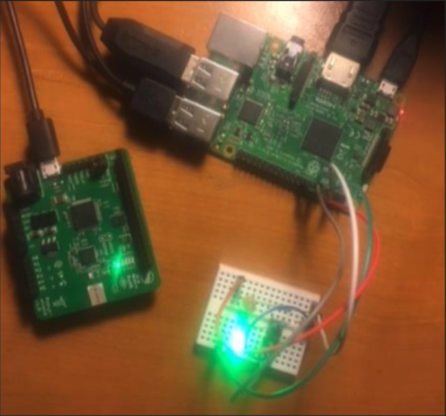
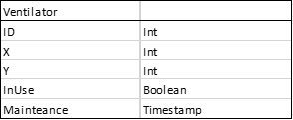

Respiratory Equipment Indoor Tracking
Team Members: Brian Weber, Alex Sabulski, Zach Davis
Faculty Advisor: Dr. Wenzhan Song
Pozyx Positioning System:
Ultra-Wideband Technology
Software:
iOS App & MySQL Database
Hardware:
Tracking Device
The Pozyx system is a hardware solution that provides accurate positioning and motion information. The system is intended for developers and consists of 5 modules: 4 anchors and a tag. In order to achieve a centimeter positioning accuracy, the Pozyx system relies on wireless radio technology known as ultra-wideband (UWB). The tag communicates with the four anchors to determine its location relative to each of the anchors.
The accuracy achieved with this technology is several times better than traditional positioning systems based on Wi-Fi, Bluetooth, RFID, or GPS signals. Furthermore, the signals can penetrate walls making it suitable for hospital wing indoor environments.
Button on enclosure indicate the current ventilator usage through LEDs which are connected to Raspberry Pi GPIO pins. The bottom of the enclosure confines rechargeable power bank that indicates battery life through separate depleting white LEDs. The top of the enclosure confines the Raspberry Pi and Pozyx shield.
Application Screenshots (left to right):
1) Loading Screen, 2) Available for use, 3) Unavailable for use
The iOS application is the GUI to display the location data to the end-user in an easy-to-read manner. By implementing an iOS library called SwiftCharts, we were able to plot our location data on a scatter plot. A layout of the floor is then overlaid on top of the scatterplot.
The Advantages of Ultr-WideBand
Enclosure Design & Internal Components
Python Script on Raspberry Pi 3 sends X and Y coordinates to Google Firebase MySQL database along with current timestamp and usage information based on a unique tracker identification number.
MySQL Database Table
Sponsor/Client: Children's Healthcare of Atlanta at Egleston

